Slide 1
Acumatica Dev Environment Deployer
Team XI - Shawn Burt, John Edwards, David Ferguson, Ilya Zhidkov
Development tool to expedite deployments of Dev Environments for development teams.

Slide 2
Acumatica Dev Environment Deployer
Credit where credit is due
This project is based on scripting work done by Brendan Hennelly. https://github.com/bhennelly/AcumaticaSourceControlDemo
We used the base scripts and concepts then automated them to allow staging and deployments of multiple versions of Acumatica.

Slide 3
The Problem
As Acumatica developers we are often having to create Dev Instances across many versions of Acumatica.
Traditional procedures to download, uninstall/install, deploy/upgrade and publishing customizations takes excessive time.

Slide 4
Solution
Acumatica Dev Instance Deployer.
This solution allows you to select from any version of Acumatica available from the Acumatica AWS S3 site.
You are also able to predeploy specified customizations.

Slide 5
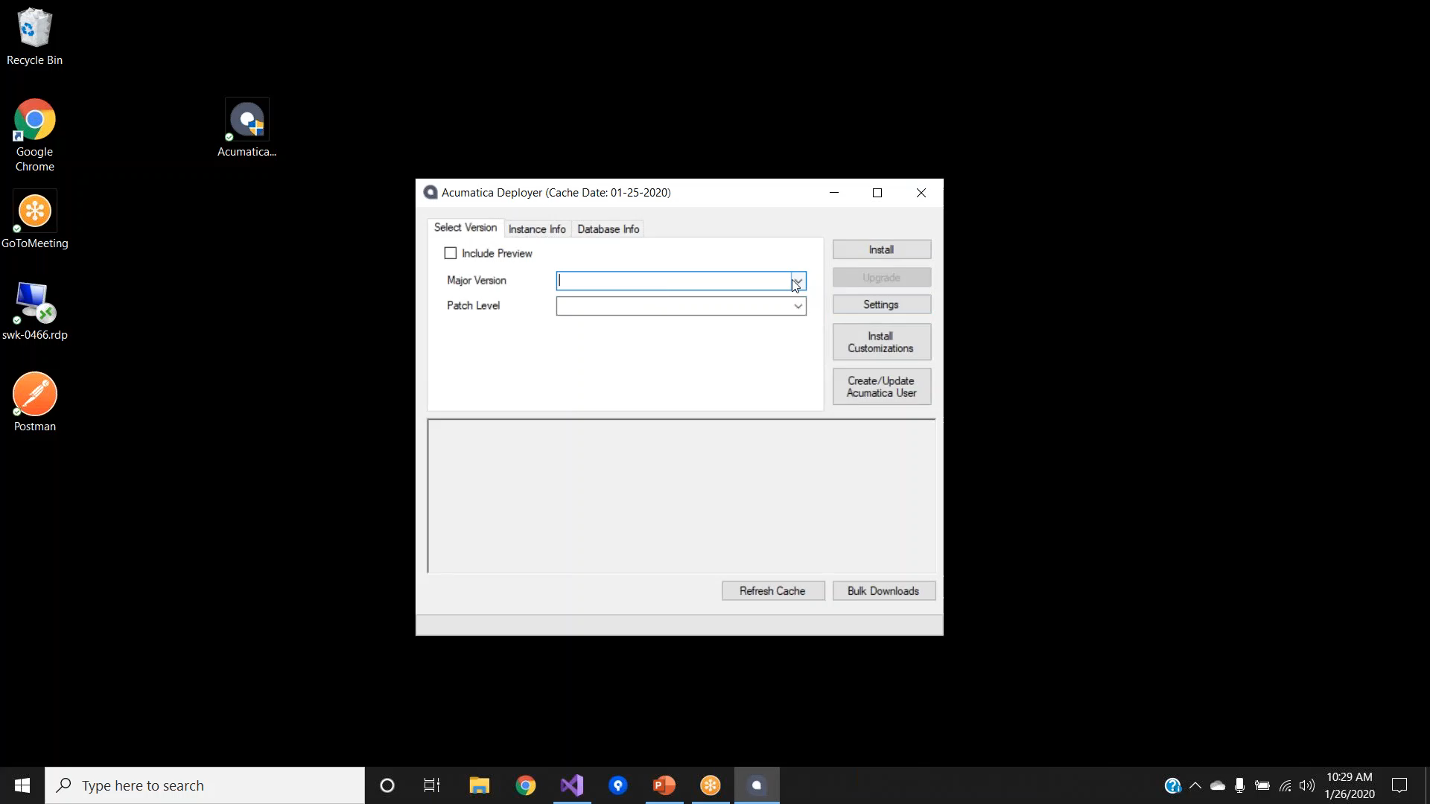
Demo

Slide 6
Q&A
Thank you.
Any Questions?

Slide 8
Shawn Burt
shawn.burt@swktech.com

